Slide 1
Exploratory Data Analysis and Data Visualization

Slide 2
Learning Objective
Understand the purpose of exploratory data analysis
Know some basic command of plotting in Base R
Use the ggplot package to plot the data out
Plot data in 3D using Plotly
Use gganimate to animate a time series data

Slide 3
Exploratory vs Descriptive, or Explanatory.
Exploratory research is usually conducted when a researcher has just begun an investigation and wishes to understand the topic generally.
Descriptive research aims to describe or define the topic at hand.
Explanatory research is aims to explain why particular phenomena work in the way that they do.
Notes:
https://scientificinquiryinsocialwork.pressbooks.com/chapter/7-1-types-of-research/

Slide 4
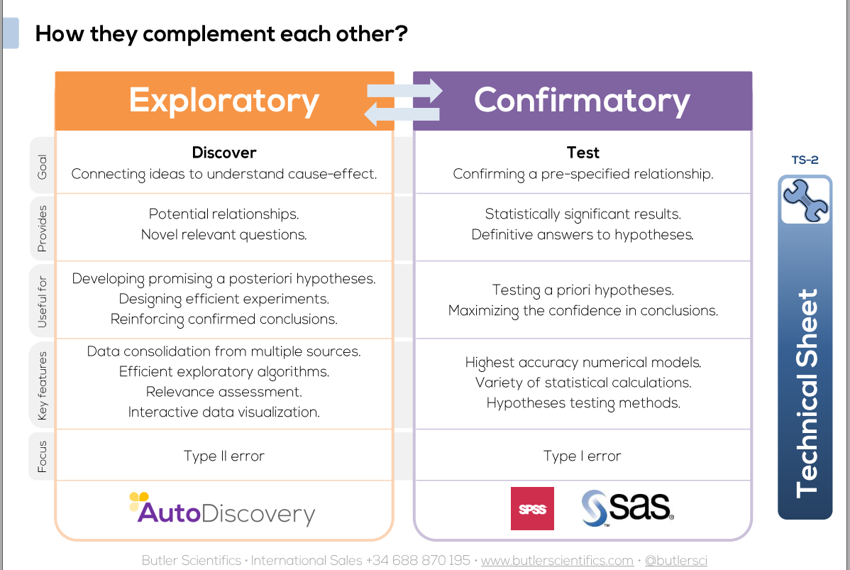
Notes:
https://www.researchgate.net/publication/267058525_Exploratory_vs_Confirmatory_Research

Slide 5
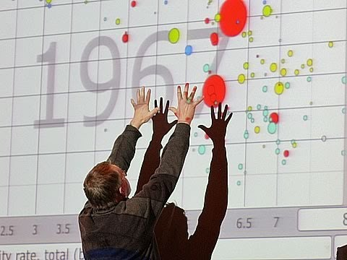
Data Visualization
The most efficient way to tell a story

Slide 6
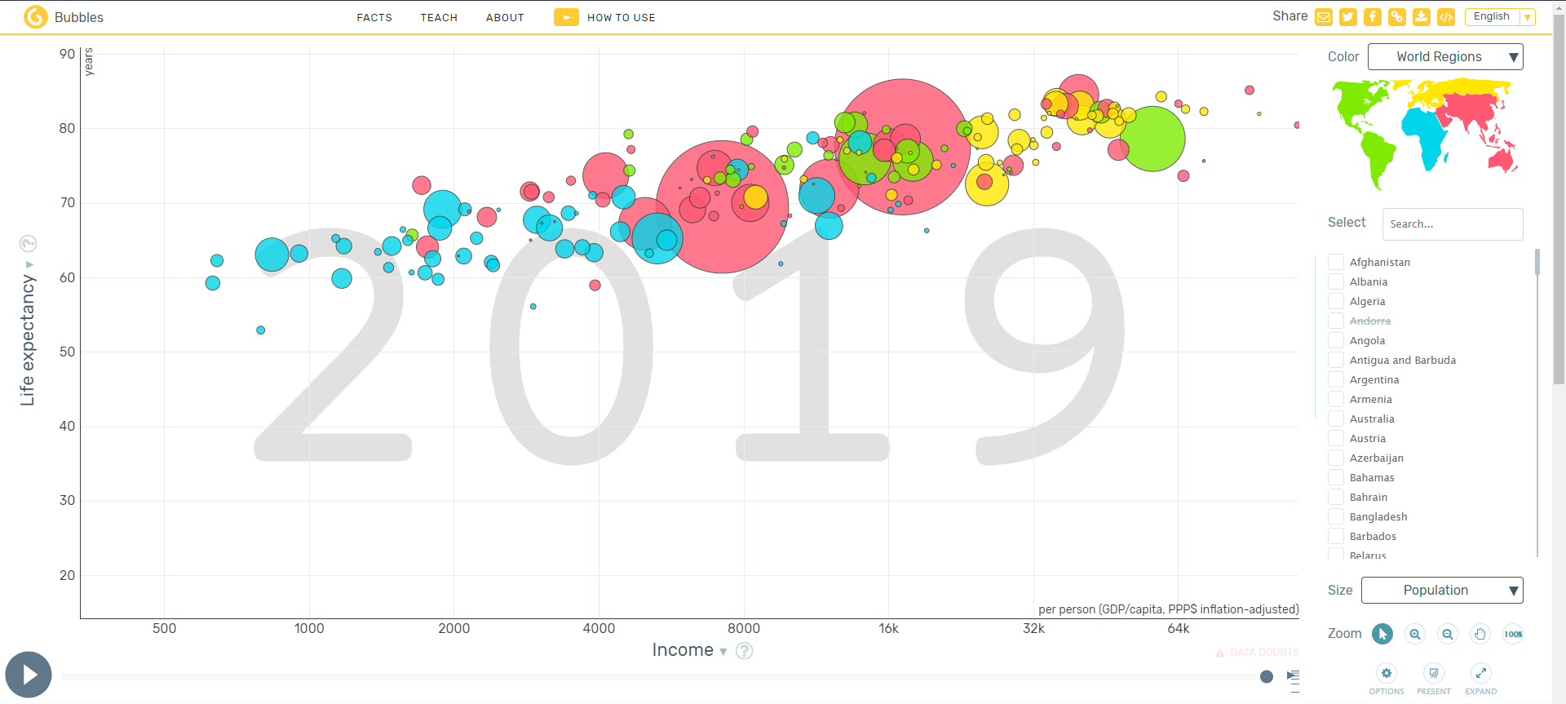
Data Visualization - Bubble chart
Notes:
https://www.gapminder.org/tools/#$model$markers$bubble$encoding$frame$value=1816;;;;;&chart-type=bubbles&url=v1

Slide 7
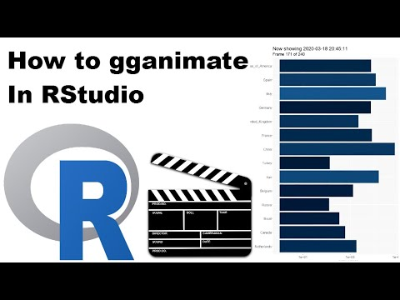
Data Visualization - Animation

Slide 8
Data Visualization
“Our eyes are drawn to colours and patterns. We can quickly identify red from blue, square from circle.
Our culture is visual, including everything from art and advertisements to TV and movies.”
Data visualization makes data more understandable , and easier to see patterns between the variables
Notes:
https://www.tableau.com/learn/articles/data-visualization

Slide 9
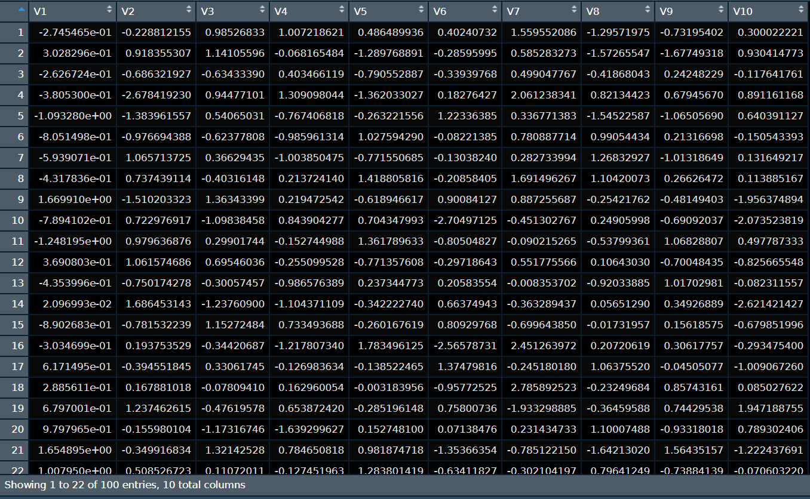
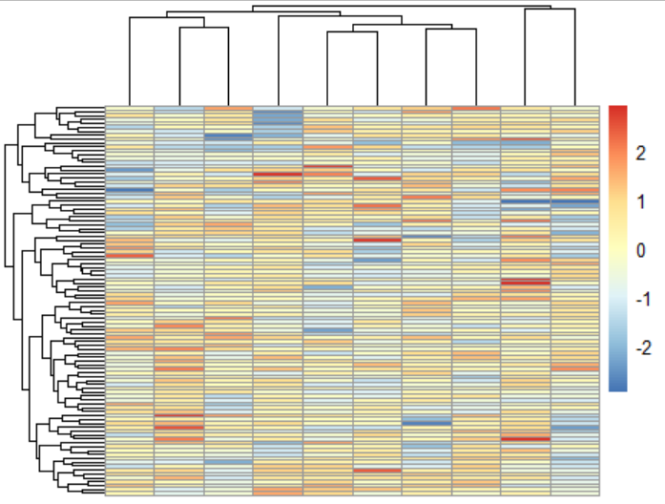
Table vs heatmap

Slide 10
Let’s head to R

Slide 11
Let’s try something
When you all are done, try this to check your understanding
https://docs.google.com/forms/d/e/1FAIpQLSe_Q2z3QnGgRgtaj13e_fB_awb3JdcDH6cHSHjA9IkQy7_FvQ/viewform

